Slide 1
Software Engineering and Architecture
Coding the HTTP in Java

Slide 2
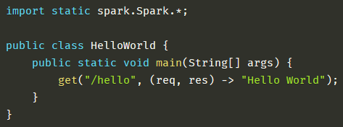
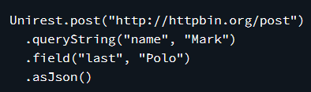
The Good News
Web is big! Lots of high quality frameworks for building both clients and servers on top of HTTP and REST!
  Google a bit around to find some…
Major qualities in teaching are
  Learnability (tutorial quality, simple API)
  Code compactness (expressiveness, code size)
UniRest Spark-Java

Slide 3
The BAD News
Good open-source libraries may be obsoleted, as the developer moves on to other exiting stuff.
Anti-Pattern: Vendor-lockin
Your product relies on out-of-date (read: security vulnerable) libraries!
Web is big! Lots of high quality frameworks for building both clients and servers on top of HTTP and REST!
  Google a bit around to find some…
Major qualities in teaching are
  Learnability (tutorial quality, simple API)
  Code compactness (expressiveness, code size)
UniRest Spark-Java

Slide 4
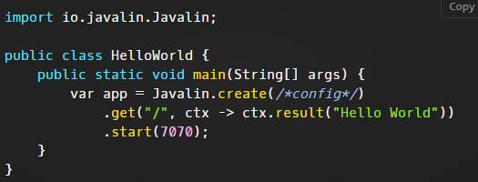
The Good News
Web is big! Lots of high quality frameworks for building both clients and servers on top of HTTP and REST!
  Google a bit around to find some…
Major qualities in teaching are
  Learnability (tutorial quality, simple API)
  Code compactness (expressiveness, code size)
UniRest Javalin
So, you spend a lot of time finding a new one, and updating 1 zillion lines of code ☹

Slide 5
Clients
UniRest

Slide 6
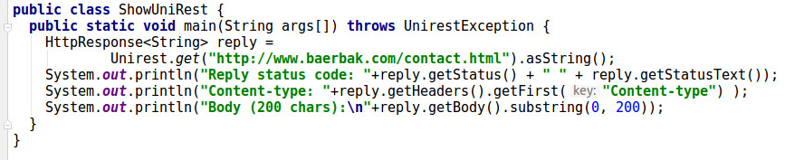
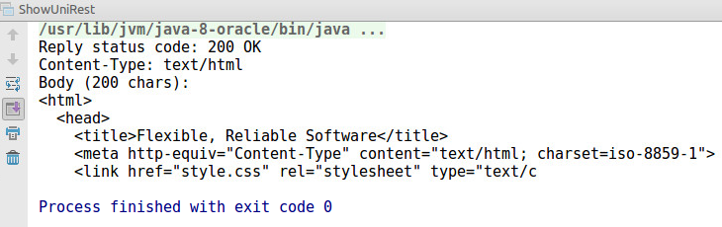
Minimal Demo
(Find it as a zip file on the weekplan)

Slide 7
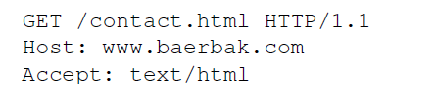
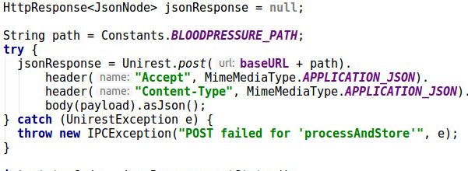
Actually a Bloch Builder
Unirest.(verb)
  Creates a verb object, but does not execute it
.queryString, .field, .header, .body
  ‘setter’ methods on the
  verb object
asJson(), asString()
  Builds and executes
  the verb
    i.e. transmits the POST on the given URL with the set parameters

Slide 8
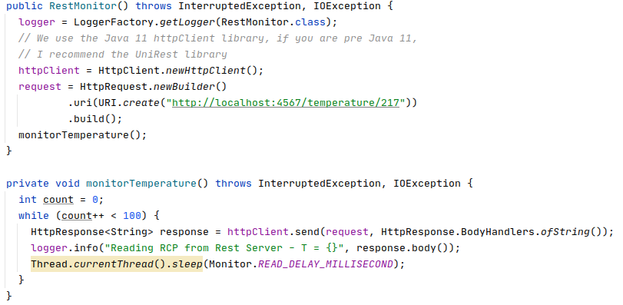
Java 11
Java 11 actually includes a Http Client library…
Ala…
But…
  I actually find
  UniRest more
  Analyzable…

Slide 9
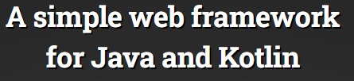
Servers
Javalin

Slide 10
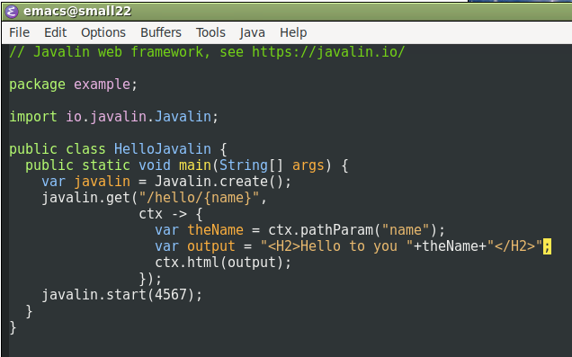
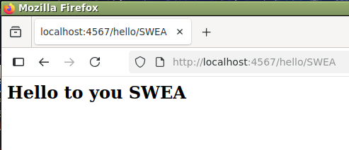
Minimal Demo
(Find it as a zip file on the weekplan)

Slide 11
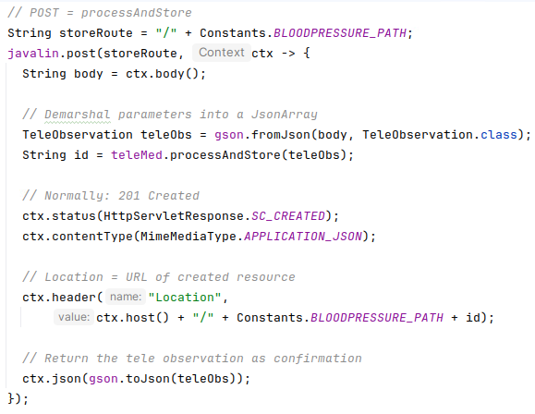
Lambda’s
Context Object (ctx):
Encapsulate both
request and reply

Slide 12
Relating to SWEA Theory
Analyzing the code
  A web browser is a rather
  complex piece of software
Exercise
  So – what is ‘get()’ method
  here in relation to the
  Javalin framework?
Notes:
Answer: Javalin is framework, and HTTP verbs + routes are hot spots that are configured and dependency injected into that web server. It must be Template method via separation, as the ‘get()’ method accepts a route (which URL to associate with the get), as well as a lambda method (the Strategy pattern delegate to invoke, once that URL is visted).

Slide 13
Summary
Rule #1 in software engineering:
  Someone has probably solved this problem before
So – go look for candidates
  Timebox the learning curve and quality assessment
    I have found Open Source libraries that were
      Extremely hard to understand and use
      Often also full of defects and inconsistencies
      Not maintained recently and thus becoming insecure
  Pick the best candidate
    And prepare for do over
    [And perhaps eventually, migrate to another library ☹]

